Slide 1

Tableau

Slide 2
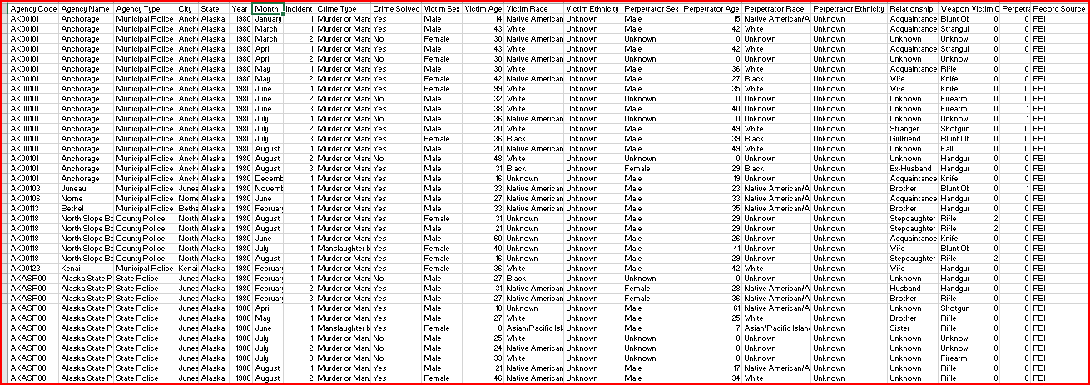
CRIME Analysis
DATASET

Slide 3
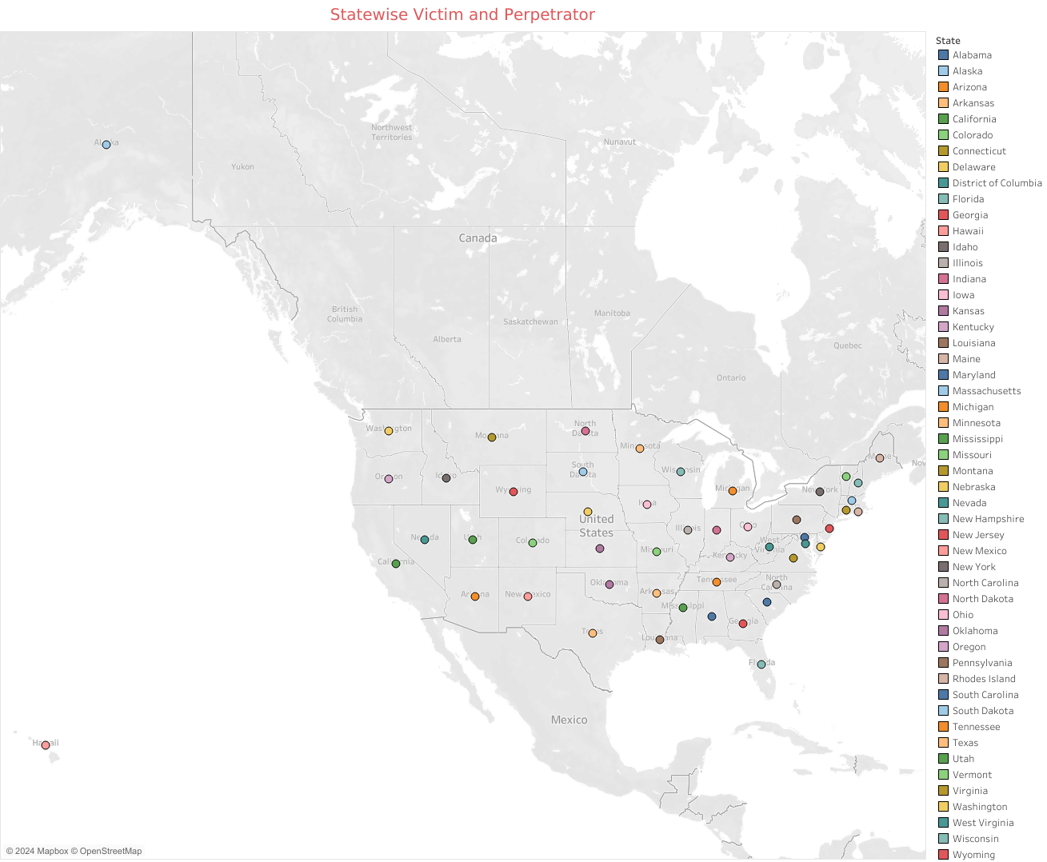
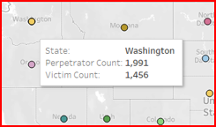
Geographical Insights into Victims and Perpetrators by State

Slide 4
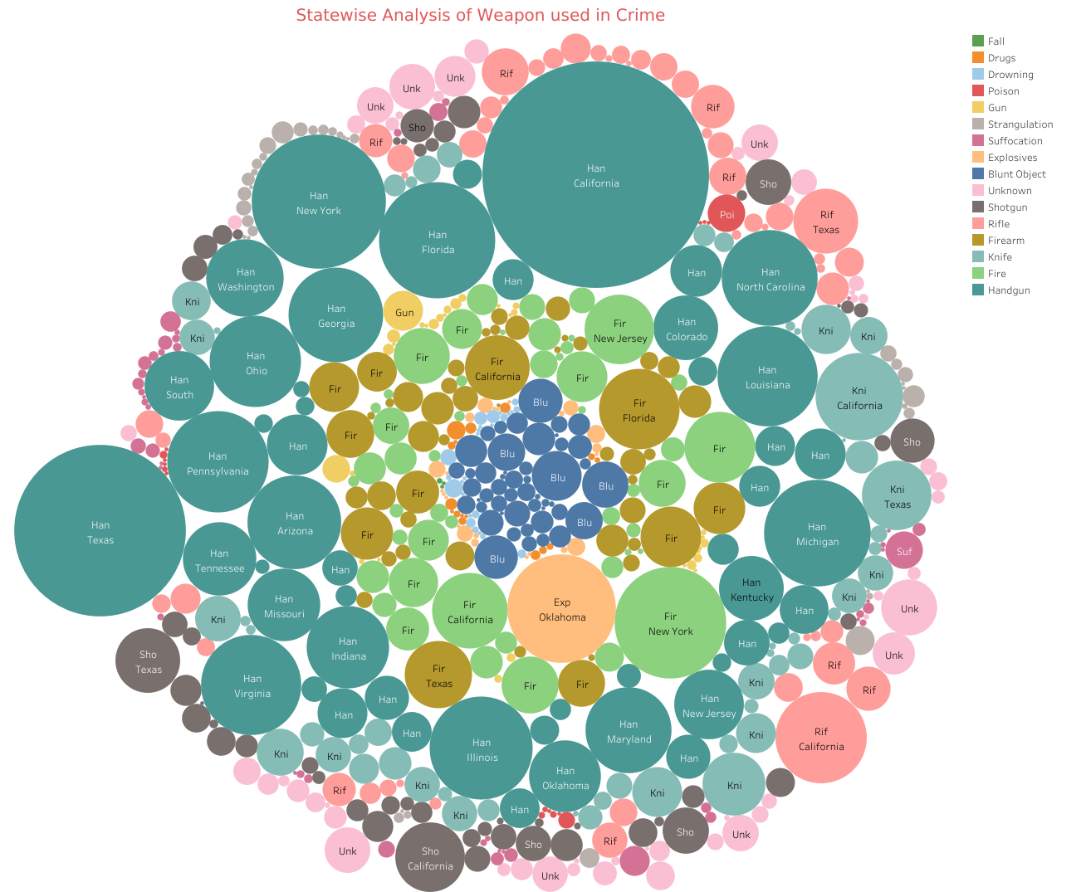
Bubble Chart for Examining Weapon Types Used in Crime by State

Slide 5
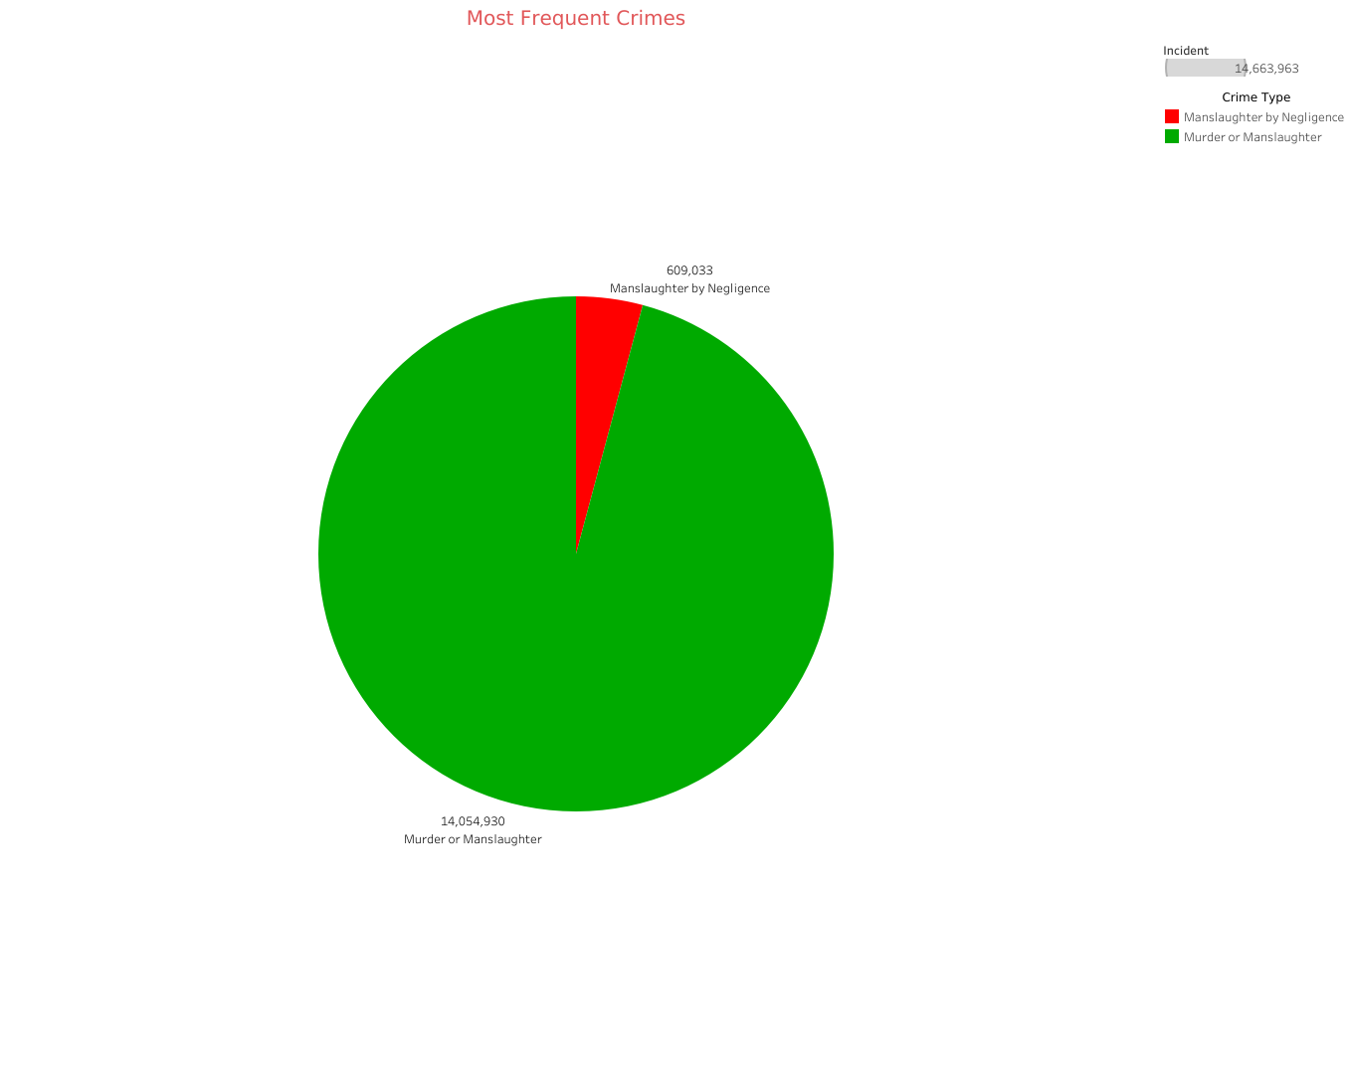
Pie Chart for Most Common Crimes Visualizing

Slide 6
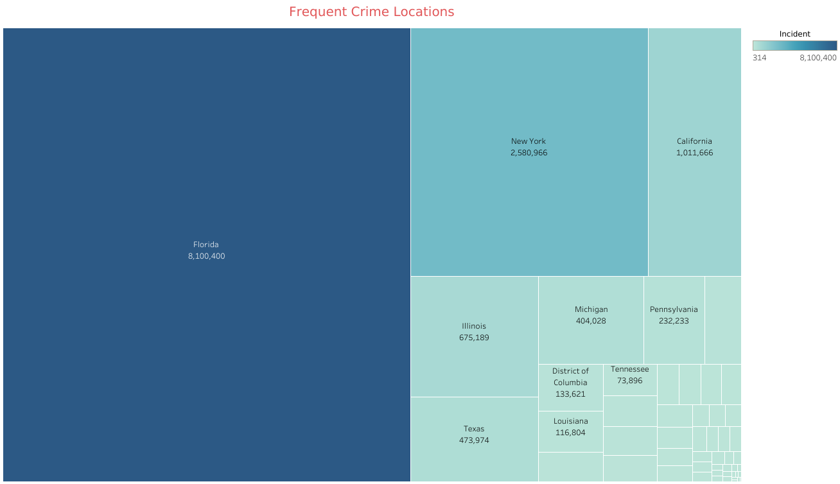
Tree Map for Identifying High-Frequency Crime Areas

Slide 7
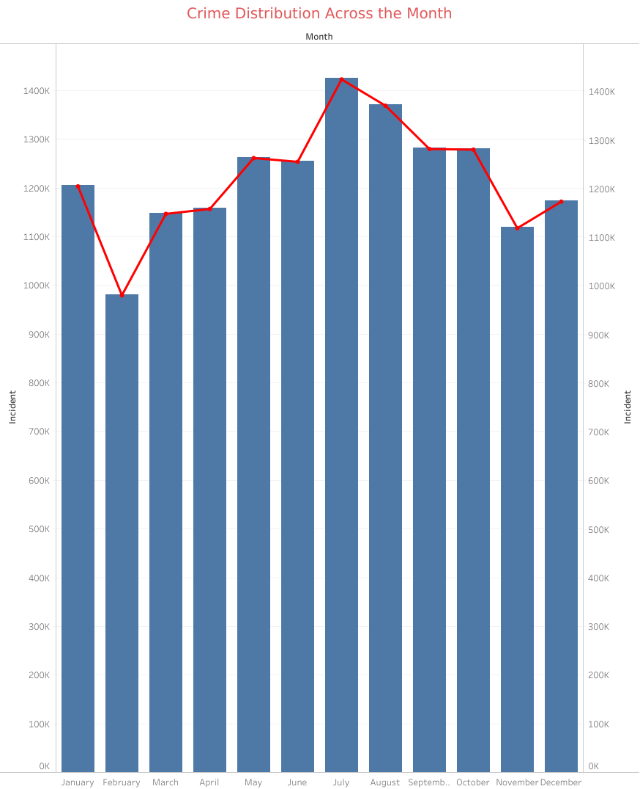
Dual Axis Analysis of Monthly Crime Distribution using Bar and Line Chart

Slide 8
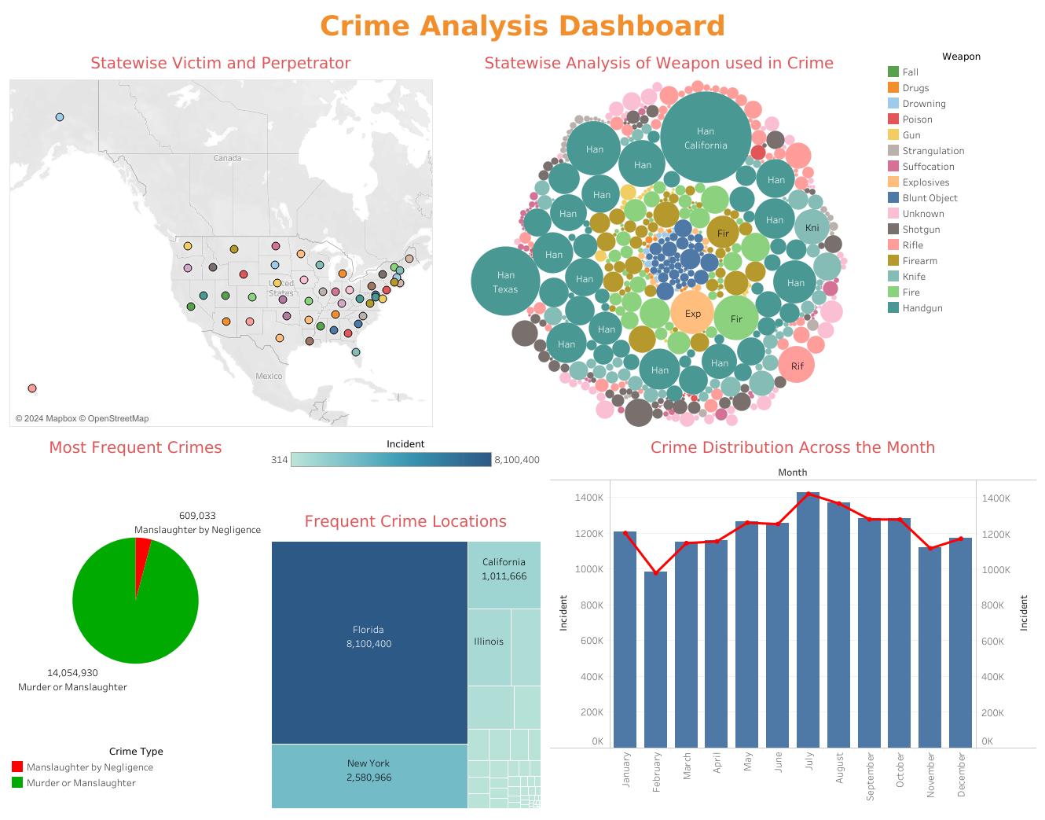
Crime Insights Dashboard

Slide 9
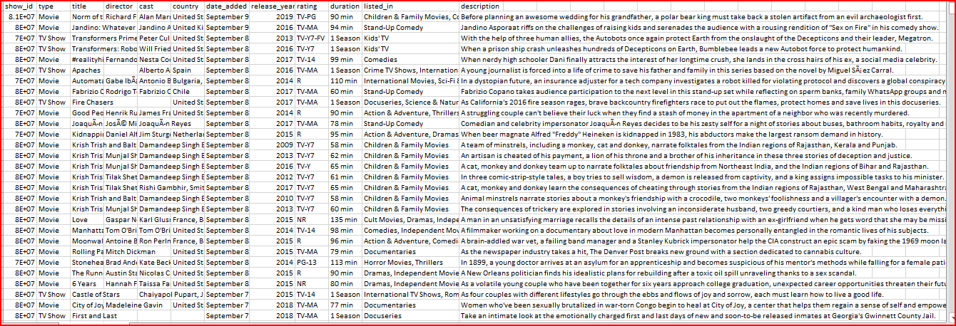
Netflix Analysis
DATASET

Slide 10
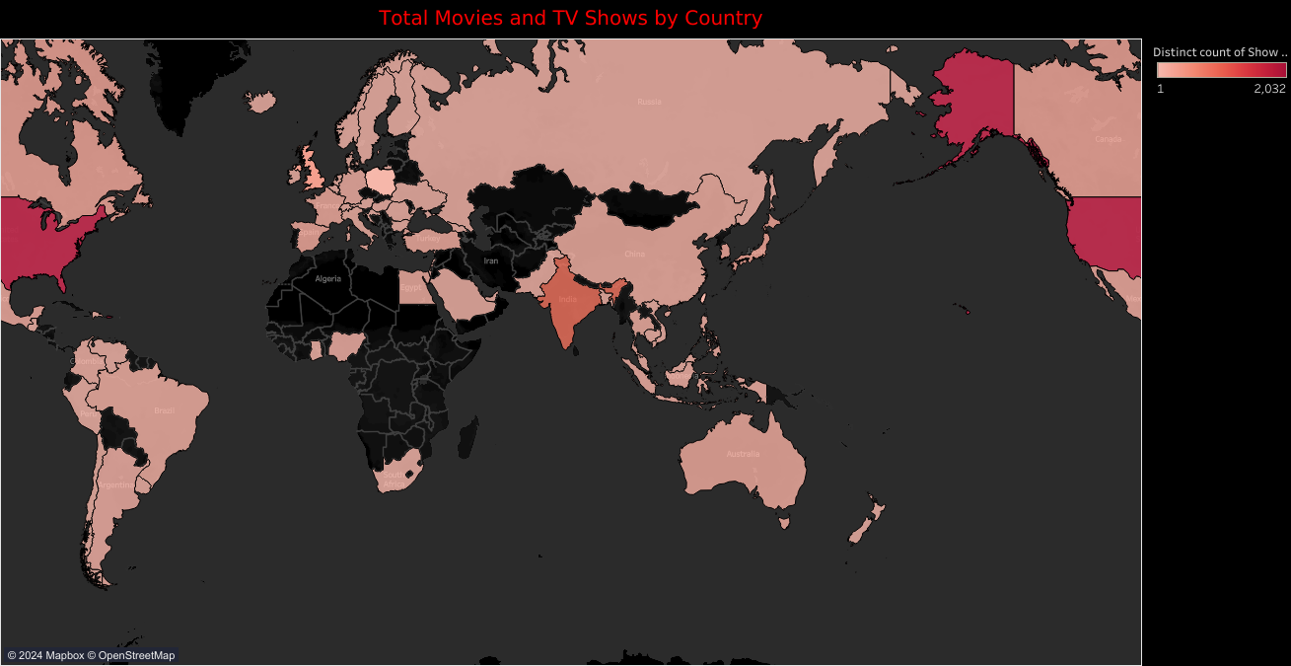
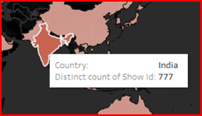
Mapping the World of Entertainment for Movies and TV Shows by Country

Slide 11
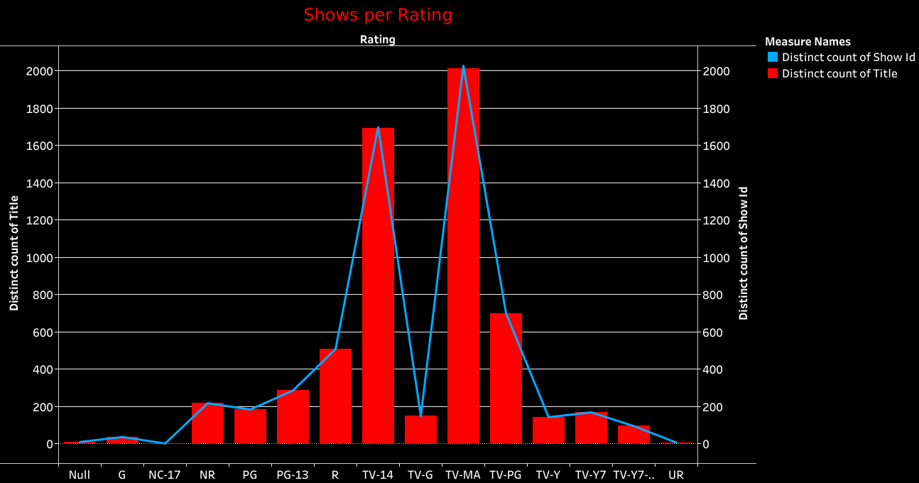
Dual Axis Analysis of Shows by Rating

Slide 12
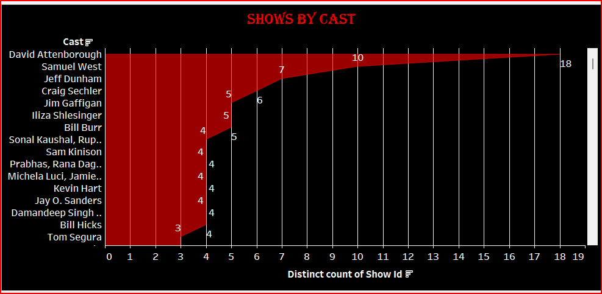
Area Chart for Distribution of Shows by Cast Members

Slide 13
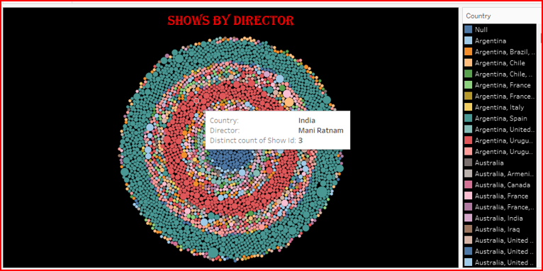
A Circle Bubble Chart Visualization for Shows by Director

Slide 14
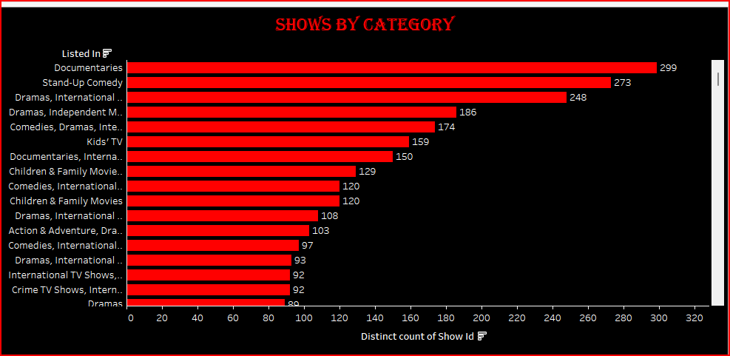
Distribution of Shows by Category using Bar Chart

Slide 15
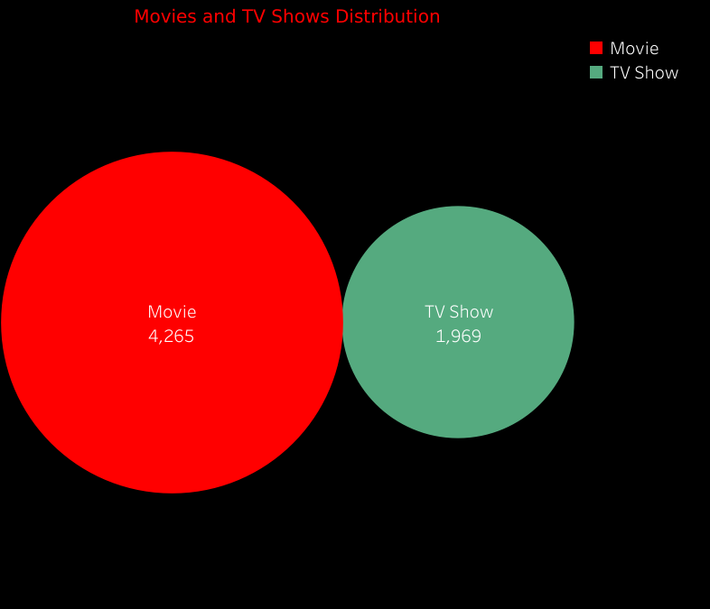
Analyzing the Distribution of Movies and TV Shows

Slide 16
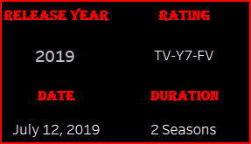
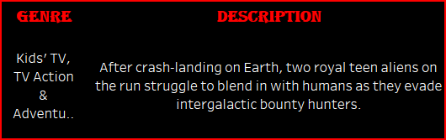
Key Content Attributes

Slide 17
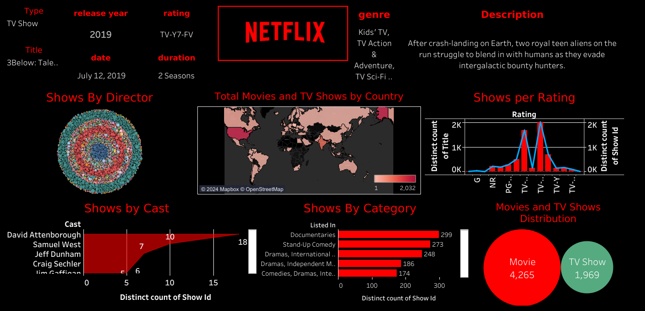
Netflix Analytics Dashboard

Slide 18
LINK FOR ACCESS THE DASHBOARD
Here is the URL for the dashboard that I published for public access
https://public.tableau.com/app/profile/selvalakshmi.k/viz/NetflixDashboard_17288368111310/Netflix
https://public.tableau.com/app/profile/selvalakshmi.k/viz/CrimeDashboard_17287477009590/Dashboard1
Thankyou,
Selvalakshmi..

